Slide 1
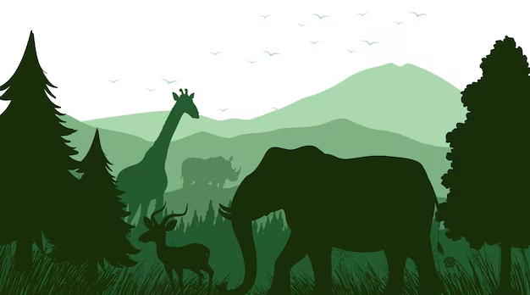
WOMANIUM Quantum + Ai project 2024
Team: Earth Saviour
My topic : Wildfire Prevention and How AI and Quantum Computing can help prevent it

Slide 2
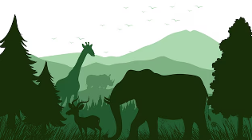
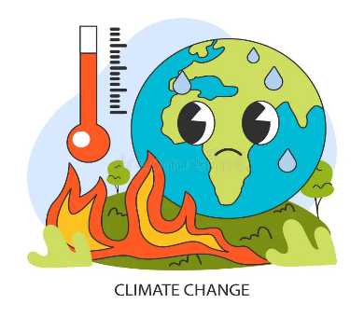
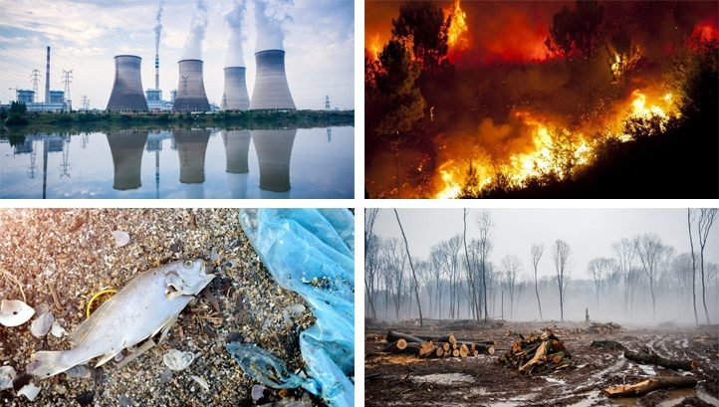
What’s the problem ?
We all know Climate Crisis is a serious problem around the Globe. There have been many problems in the last decade like heavy Rainfall leading to floods (risking human life and ecosystem), on the other side no rain at all and heat waves leading to hot and dry climate again risking life, extreme weather events, deadly wildfires, global warming, burning of fossil fuels, pollution, deforestation, environmental degradation, carbon emissions and the list goes on. This affects many things like loss of species, rising ocean, severe storms, drought, decrease in food production, increased hunger and poor nutrition in places where people cannot grow or find sufficient food. The main reason behind this is human activities since the industrialisation.
Note: Images taken from Google for reference
Womanium Quantum + AI project 2024

Slide 3
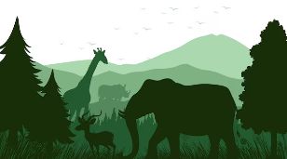
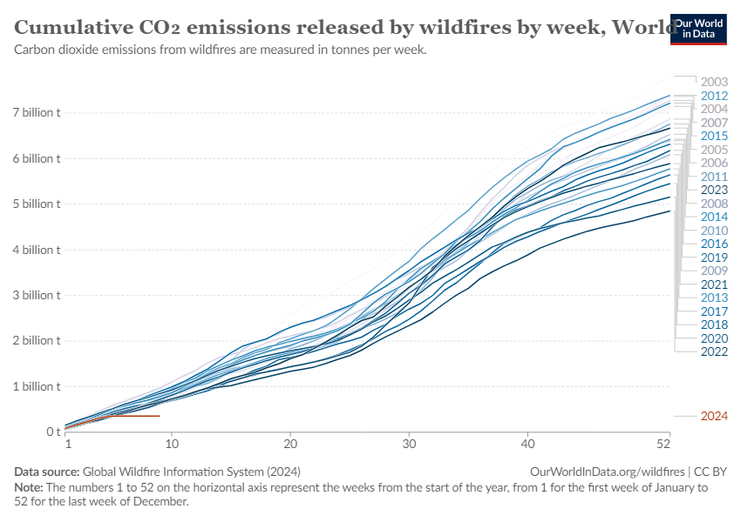
Wildfires
Wildfires have emerged as one of the most destructive natural disasters worldwide, causing significant economic losses and long-term ecological damage. It is important to note that while only a small percentage (3%–5%) of wildfires exceed 100 hectares in size, the largest 1% of fire is responsible for a staggering 80%–96% of the total area burned. Wildfires pose a direct threat to communities around the world, endangering lives and leading to potentially life-threatening consequences. Additionally, they have severe impacts on air quality, water availability and quality, as well as soil integrity. The term “megafire” was coined after the devastating 2000 U.S. wildfire season, as a reflection of the perception that wildfires, both in the United States and globally, were reaching unprecedented levels in terms of size, impact, and severity. This escalation can be attributed, at least in part, to changing climate patterns and aggressive fire suppression strategies.
Womanium Quantum + AI project 2024

Slide 4

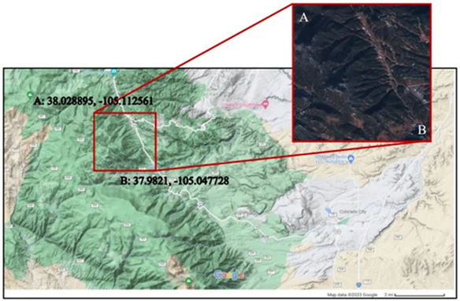
While researching the problem of how we can detect the area with wildfires, I came across many blogs, articles, websites, working towards it and succeeded. Most of them have discussed AI approach and satellite interactions.
The satellite taking images, AI with the help of image detection, using its own method from datasets, neural networks and deep learning, identifying differences in satellite images ( changes in colour, red or dark orange). Night time images are easier to identify in comparison to day time (due to clouds, dust, other atmospheric conditions). This can be a big problem.
i) Satellite image shows area latitude and longitude GPS coordinates in decimal degrees
Womanium Quantum + AI project 2024
Notes:
4

Slide 5
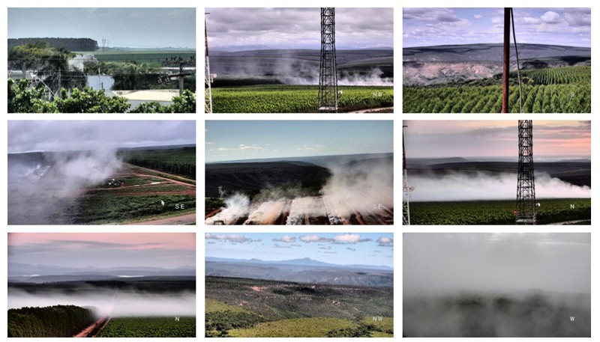
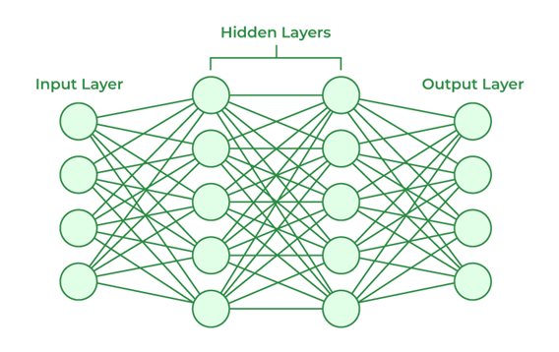
The dataset lays the groundwork for machine learning, shaping the model's ability to learn and make accurate predictions. Datasets comprising of many footage and images from different cameras with and without fires. We should be careful that these datasets are not biased and Data labelling are accurate or it may lead to poor performing model.
Neural Networks Architecture
ii) Samples of image datasets with and without fire or smoke
Womanium Quantum + AI project 2024

Slide 6
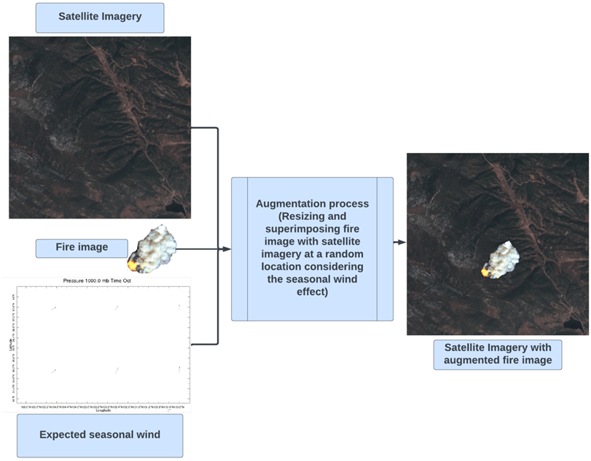
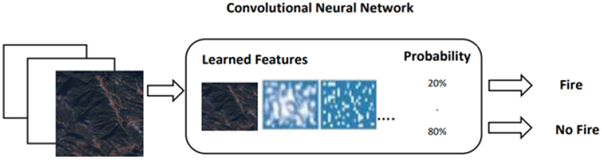
Several teams in different tasks, each one focused on trying different approaches: mobile-net, semantic segmentation, Convolutional Neural Networks (CNNs) — from simple architectures to more sophisticated ones.
Testing the model, training over patches, data augmentation, etc. This is just an overview, actual process is very complex. But with the great team, comes the best product.
iii) Deep learning workflow: Images are passed to the CNN to learn features and classify objects automatically.
ii) Augmentation of fire image in satellite imagery
Womanium Quantum + AI project 2024

Slide 7
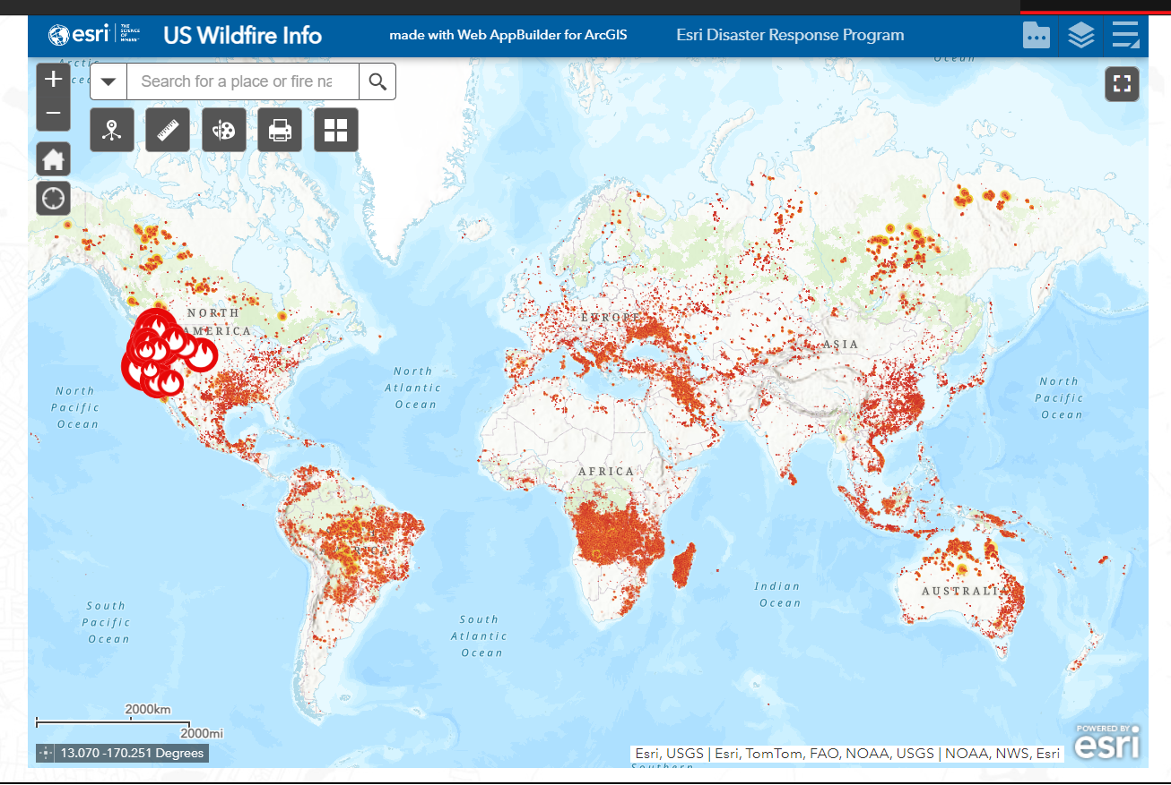
This is the recent picture from a website
esri-Uk. The picture shows the current California wildfire disaster. This application is built with ArcGIS, it uses GIS (Geographic Information System), The mapping and data analysis technology, visualize and analyze data on a map, creating in-depth insights. GIS connects data to a map, integrating location data (where things are) with all types of descriptive information (what things are like there). This provides a foundation for mapping and analysis that is used in science and almost every industry. GIS helps users understand patterns, relationships, and geographic context. The benefits include improved communication, efficiency, management, and decision-making.
Womanium Quantum + AI project 2024

Slide 8
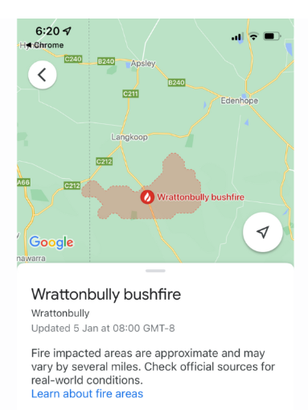
Google Research’s open source Wildfire Simulation
Google Research is applying AI and ML to better understand the Earth's physical processes and enhance our ability to react to natural disasters such as wildfires.
Research teams have collaborated with wildfire experts - by using satellite imagery and ML to detect and track wildfires, by informing affected communities and helping fire authorities to take action, and by developing a simulator to generate data in a range of wildfire scenarios.
Wildfire Boundary Tracking shows the affected area with wildfires, alerts people with red boundaries.
Link: https://lh3.googleusercontent.com/x_p0jHtHv-QhNBwzIeZ73Fx8t6rV5l1E__O4EZPrshc0v5qCeDmZQ-k8ICit_6ft05_2yb76EH3PeQbuUokVwhFd9zbPoatKqgwNJyCM=w2880-e365-pa-nu
Please play the above video link to have a look how it alerts with the affected area
Note: Image and video links are referenced in readme file
Womanium Quantum + AI project 2024

Slide 9
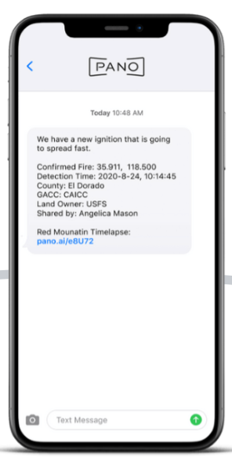
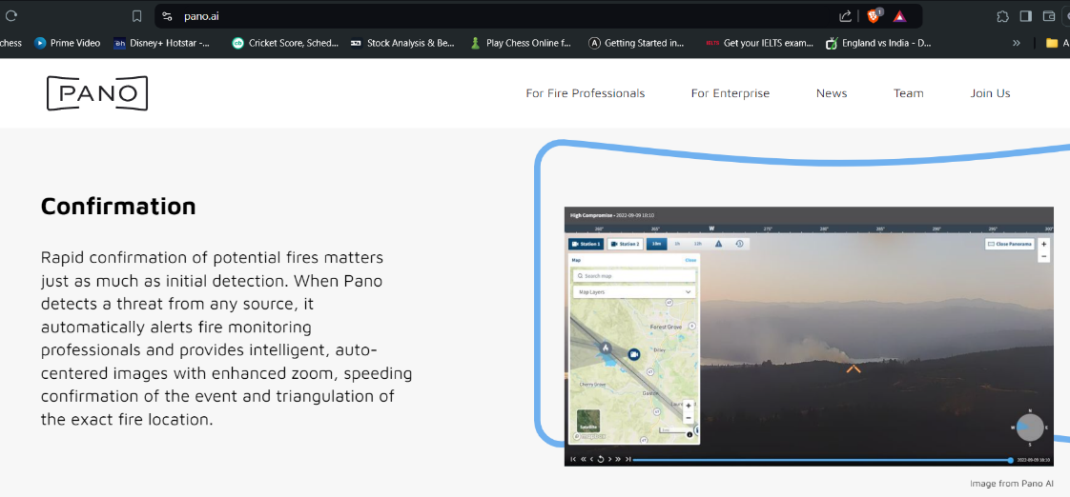
Pano AI Application
Pano is a California based Wildfire detection and management company which uses advanced hardware, artificial intelligence, and software. Leveraging data and satellite feeds, as well as propriety imagery from a network of ultra-high-definition, 360-degree cameras atop high vantage points, Pano’s artificial intelligence model produces a real-time picture of threats in a geographic region and delivers immediate, actionable intelligence.
Womanium Quantum + AI project 2024

Slide 10
AI and quantum computing can significantly contribute to decreasing, predicting, and mitigating wildfires globally by enhancing early detection, improving prediction accuracy, optimizing resource allocation, and supporting effective decision-making. Here’s a detailed look at how these technologies can be utilized:
AI in Wildfire Prevention and Management
Early Detection:
Satellite and Drone Surveillance: AI algorithms can analyze satellite images and data from drones to detect signs of wildfires, such as smoke or thermal anomalies, even in remote areas.
IoT Sensors: Networks of IoT devices equipped with AI can monitor environmental conditions (e.g., temperature, humidity, wind speed) in real-time, providing early warnings when conditions are conducive to fire ignition.
Womanium Quantum + AI project 2024

Slide 11
2. Prediction:
Data Analysis: AI can analyze historical wildfire data, weather patterns, vegetation types, and human activity to predict the likelihood of wildfires in specific areas.
Machine Learning Models: Advanced machine learning models can simulate fire spread under various scenarios, helping to predict the path and intensity of wildfires.
3. Resource Allocation:
Optimization Algorithms: AI can optimize the deployment of firefighting resources, such as personnel, equipment, and water, ensuring they are available where and when needed most.
Logistics Management: AI systems can manage the logistics of evacuations, supply distribution, and other emergency response activities, ensuring efficient use of resources.
4. Decision Support:
Risk Assessment: AI can provide real-time risk assessments, helping authorities prioritize actions and make informed decisions quickly.
Scenario Planning: AI can assist in planning and executing controlled burns and other preventive measures by simulating various scenarios and outcomes.
Womanium Quantum + AI project 2024

Slide 12

Detecting fire from satellite images using AI involves several key algorithms and techniques, primarily centered around neural networks, machine learning, and deep learning. Here are some of the key concepts and methods:
1. Convolutional Neural Networks (CNNs)
Convolutional Neural Networks are the backbone of image detection tasks, including fire detection from satellite images. CNNs are designed to automatically and adaptively learn spatial hierarchies of features from input images.
Architecture Overview:
Input Layer: Takes the satellite image as input.
Convolutional Layers: Apply convolution operations to the image, using filters to detect features such as edges, textures, and specific patterns (like smoke or flames).
Activation Function : Introduces non-linearity, allowing the network to learn more complex patterns.
Pooling Layers: Reduce the dimensionality of the feature maps, retaining the most important information.
Fully Connected Layers: Interpret the features and make predictions, such as classifying an image
as containing fire or not.
Womanium Quantum + AI project 2024

Slide 13
Fully Connected Layers: Interpret the features and make predictions, such as classifying an image as containing fire or not.
Output Layer: Provides the final classification, often using a softmax function to give probabilities for the presence of fire.
Equation for Convolution Operation:
( I ∗ K ) ( x , y ) = ∑_{m} ∑_{n} I (x + m, y + n) K ( m, n )
Where:
I is the input image.
K is the kernel (filter).
x , y are the coordinates in the resulting feature map.
m, n are the coordinates in the kernel.
Womanium Quantum + AI project 2024

Slide 14

2. Artificial Neural Networks (ANNs) and Classification
If using a more traditional approach, ANNs can be applied after extracting features using methods like Histogram of Oriented Gradients (HOG) or Principal Component Analysis (PCA) for dimensionality reduction.
ANN Basic Structure:
Input Layer: Receives the feature vector extracted from the satellite image.
Hidden Layers: Perform complex transformations and learn patterns in the data.
Output Layer: Predicts the likelihood of fire presence.
Forward Propagation:
a ^{[l]} = g ( w ^{[l]} a ^{[l-1]} + b ^{[l]} )
Where:
a^{[l]} is the activation of layer l.
w^{[l]} are the weights.
b^{[l]} are the biases.
g is the activation function (e.g., ReLU or Sigmoid).
Womanium Quantum + AI project 2024

Slide 15
Quantum Computing in Wildfire Prevention
and Management
1. Enhanced Computational Power:
Complex Simulations: Quantum computers can perform complex simulations of wildfire behavior faster and more accurately than classical computers, allowing for better prediction and understanding of fire dynamics.
Climate Modeling: Quantum computing can improve the accuracy of climate models that predict long-term trends in weather patterns, which are crucial for understanding and anticipating wildfire risks.
2. Optimization Problems:
Resource Distribution: Quantum algorithms can solve complex optimization problems more efficiently, such as determining the best way to distribute firefighting resources across a large region with many variables.
Route Planning: Quantum computing can optimize evacuation routes and resource delivery paths in real-time, accounting for rapidly changing fire conditions.
Womanium Quantum + AI project 2024

Slide 16
3. Big Data Processing:
Data Integration:
Quantum computing can handle and process large datasets from various sources (satellites, sensors, historical records) more efficiently, enhancing the quality and speed of AI models used for detection and prediction.
Real-Time Analysis:
The increased computational power of quantum computers allows for real-time or near-real-time analysis of data, which is crucial for timely decision-making during wildfire emergencies.
Womanium Quantum + AI project 2024

Slide 17
Quantum Computing Algorithm
In quantum computing, algorithms like Quantum Support Vector Machines (QSVMs) or quantum-enhanced neural networks could be used to process large datasets more efficiently.
Quantum SVM:
Quantum kernels can map data into a higher-dimensional space, enabling better separation of classes (e.g., fire vs. no fire).
The quantum version of SVM can potentially offer exponential speed-ups in training time for large datasets.
QSVM Equation:
f(x) = sign( ∑^{N}_{i=1} α_{i} y_{i} K ( x_{i} , x) + b )
Where:
a_{i} are the Lagrange multipliers.
y_{i}​ are the labels.
K(x_{i}​ , x) is the quantum kernel function.
Womanium Quantum + AI project 2024

Slide 18
Practical Implementation and Global Impact
Integration of Technologies:
Combining AI and quantum computing involves creating systems that can seamlessly integrate data from multiple sources, process it rapidly, and provide actionable insights.
Scalability:
These technologies can be scaled to monitor vast and diverse landscapes, from forests and grasslands to urban areas, providing global coverage and enhancing international cooperation in wildfire management.
Cost-Effectiveness:
As AI and quantum computing technologies advance and become more cost-effective, their adoption in wildfire management will increase, benefiting both developed and developing regions.
Womanium Quantum + AI project 2024

Slide 19
Conclusion
The integration of AI and quantum computing offers a powerful approach to reducing the impact of wildfires globally. AI enhances early detection, prediction, and resource optimization, while quantum computing provides the computational power needed for complex simulations and real-time data processing. Together, these technologies can significantly improve our ability to predict, prevent, and manage wildfires, ultimately protecting lives, property, and ecosystems. However, successful implementation requires overcoming technical challenges, ensuring data integration, and making these advanced technologies accessible and affordable worldwide.
Womanium Quantum + AI project 2024

Slide 20
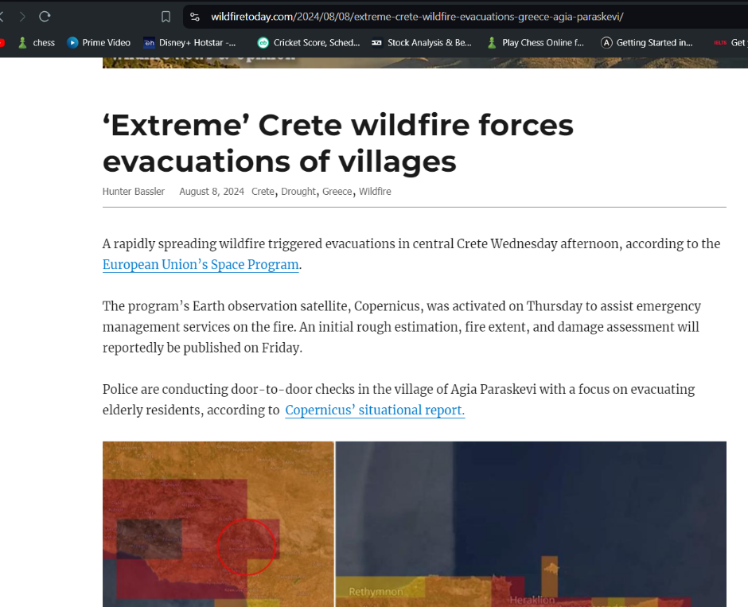
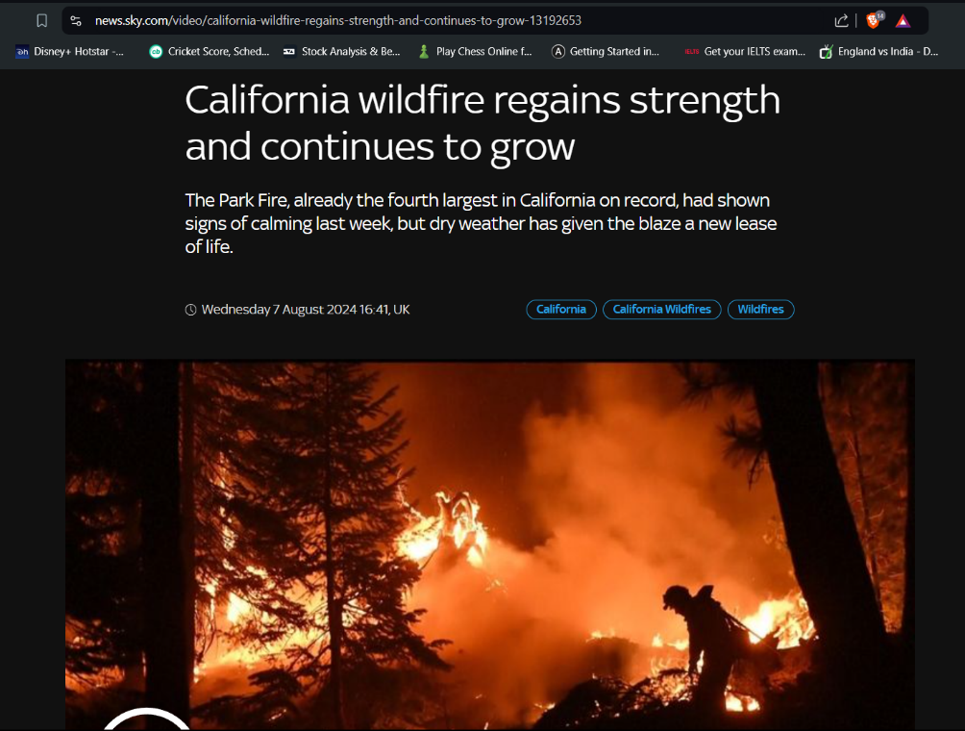
Two of the most recent fire disasters, in Greece and California, dating 8th and 7th of August 2024
respectively. Let's harness the power of technology to not just control wildfires, but to outsmart and prevent them before they ignite, because we are making progress but the fires have yet not stopped.
Womanium Quantum + AI project 2024

Slide 21
Image and Reference Links used
for research
Slide 3 Image - Global Wildfire In formation System, link: https://ourworldindata.org/wildfires
Slide 4, 6 Image - from an Article: An Efficient Wildfire Detection System for AI-Embedded Applications Using Satellite Imagery, link: https://www.mdpi.com/2571-6255/6/4/169
Slide 5 Image – Omdena web application, link: https://www.omdena.com/blog/stop-wildfires
Slide 7 Data and Image - Esri UK, link: https://www.esriuk.com/en-gb/disaster-response/disasters/wildfires
Slide 8 Data - Google Research : Wildfire Simulation, link: https://sites.research.google/wildfires/#Wildfire-simulation
Slide 9 Images - Pano AI, link: https://www.pano.ai/
Slide 20 News links : https://wildfiretoday.com/2024/08/08/extreme-crete-wildfire-evacuations-greece-agia-paraskevi/
, https://news.sky.com/video/california-wildfire-regains-strength-and-continues-to-grow-13192653
Womanium Quantum + AI project 2024

Slide 22
Thank You
-By KHUSHI SUKAR (solo project)
Womanium Quantum + AI project 2024

